Slide 1
We are #1
Sprint Review Project Hope
Notes:
Put a nice graphic here

Slide 2

The Team
Rob O’Connor Artist
Tamara Hooijmans Artist
Humam Abud Allah Artist
Olivier de Haan Designer
Rick Oosthof Designer
Glyn Leine Engineer
Notes:
Put proper roles here

Slide 3
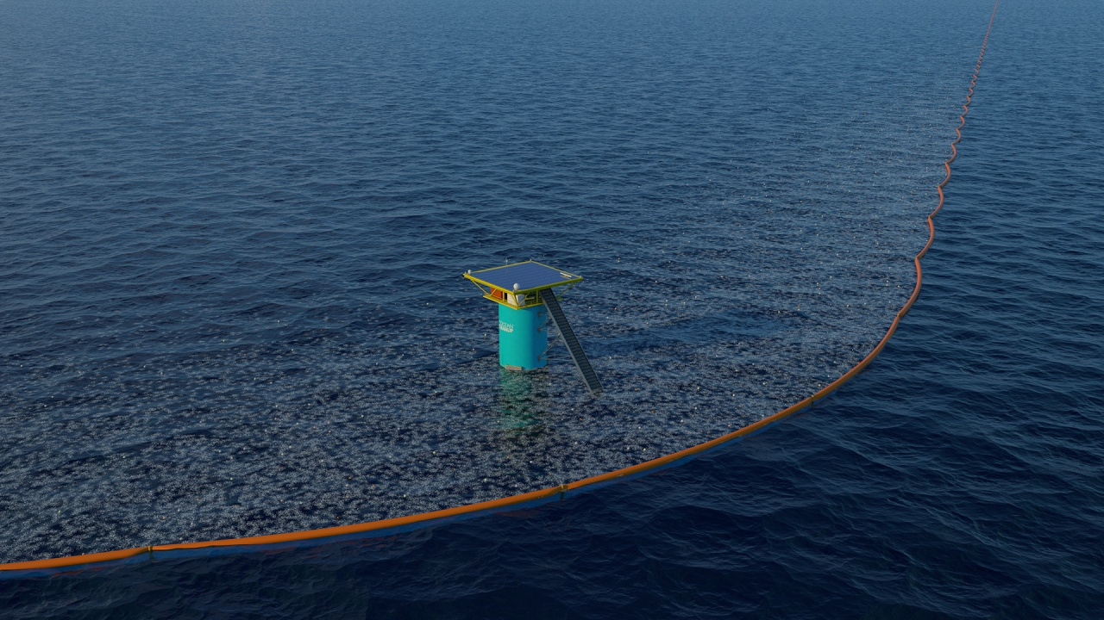

Notes:
Ocean cleanup is a Rotterdam based organization dedicated to cleaning up the great garbage patches, currently deploying in the biggest and most researched one: the north atlantic patch

Slide 4
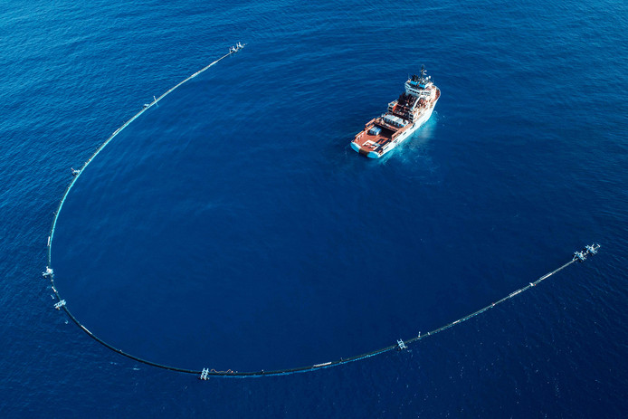
Research
Notes:
Ocean cleanup/message of hope/informing new audiences is important

Slide 5
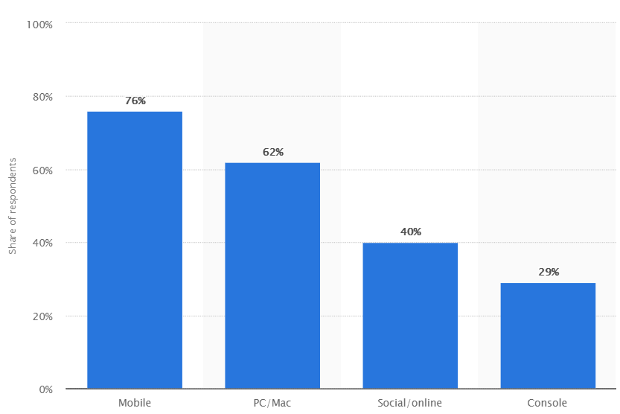
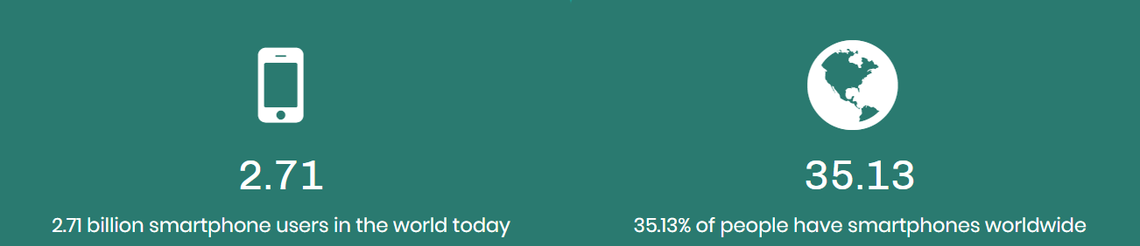
Notes:
Biggest audience in the world for a unity3d product is mobile games

Slide 6
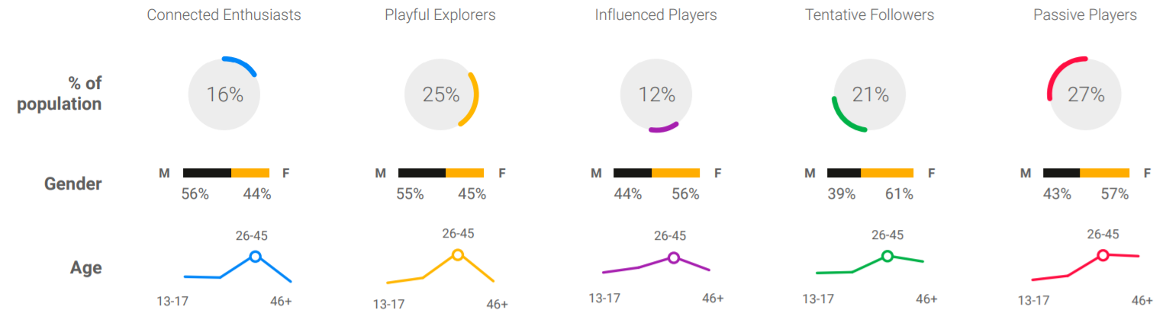
Notes:
5 types in total

Slide 7
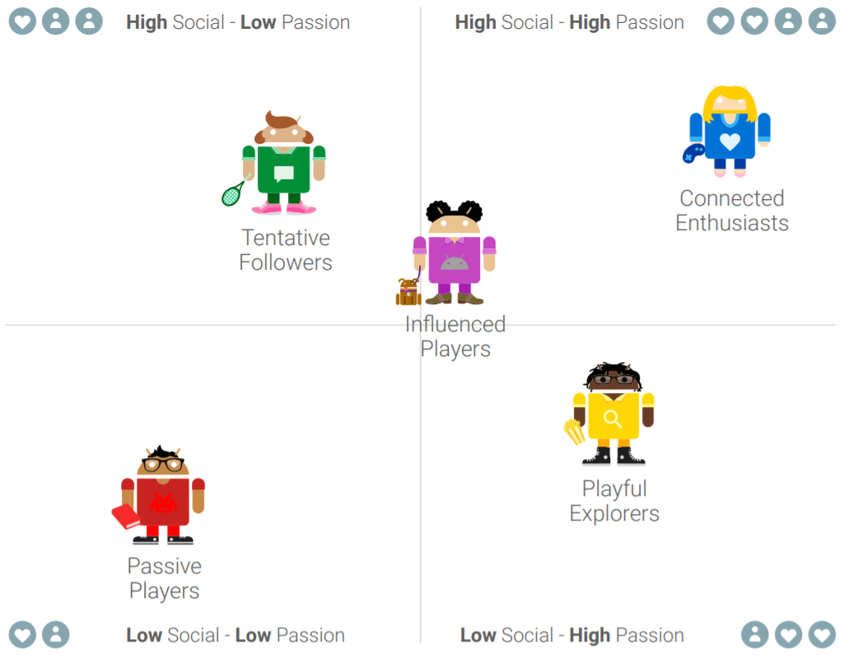
Notes:
High passion so most likely to try our game = connected enthusiasts & playful explorers

Slide 8
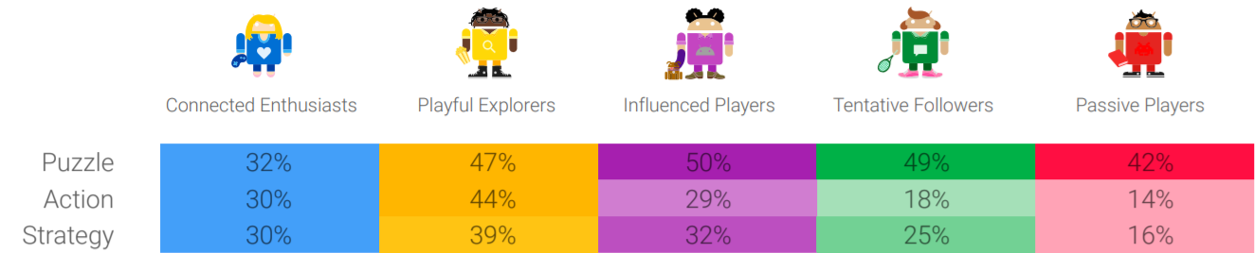
Notes:
Aka we had 3 choices of game type, now puzzle was the biggest by far but we decided to brainstorm a few game ideas that we liked and thought were fun and action seemed like the most fun

Slide 9

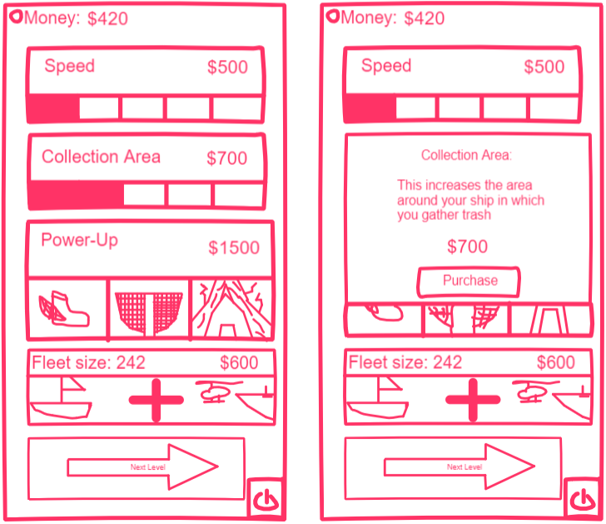
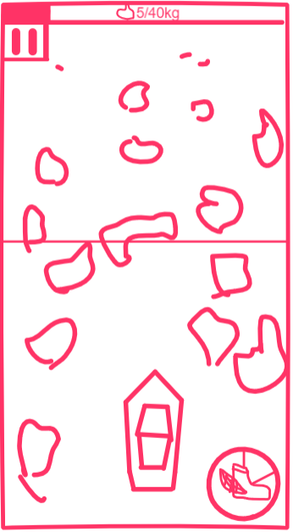
The Game
Notes:
You just lost it

Slide 10
Mention about all the planning documents we have?(GDD/Asset lists/trello/git)
Make sure to explain theyre living breathing documents that will keep getting edited during the project they’d eat that shit up ya dig
Also a natural place to mention trello/github/sourcetree/discord/whatsapp but at the start after the team section is also OK
Notes:
Show how good we are at planning

Slide 11
UI Wireframe Section
Notes:
Short bit where I go over the process of making the wireframes

Slide 12
Moodboard Section
Notes:
Moodboard and possibly iterations?

Slide 13
Stylesheet Section
Notes:
Whats our style

Slide 14
Concept Art Section
Notes:
Many slides of concept art/our art style

Slide 15
Engineer Section
What did glyn do this week(doesn’t actually have to be presented by Glyn)
Notes:
Not the git document that’s earlier it’s the programming that’s the answer

Slide 16
Demo slide(gif/video?)
Notes:
Boat shoots trash

Slide 17
Next week
Notes:
Next week sprint backlog, what are we planning on doing next week?(nice quick fire list)

Slide 18
Thank you for listening

